Slide 1
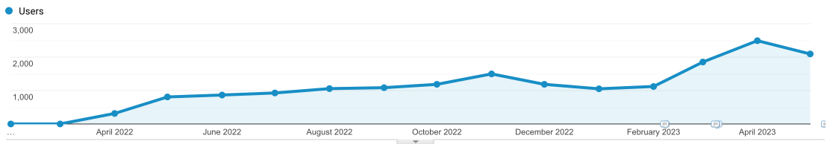

Case Study: From 0 to 2500 visitors by just optimizing content for a shoe store

Slide 2
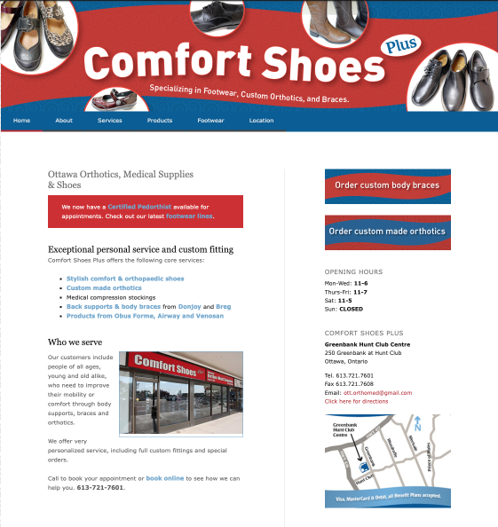
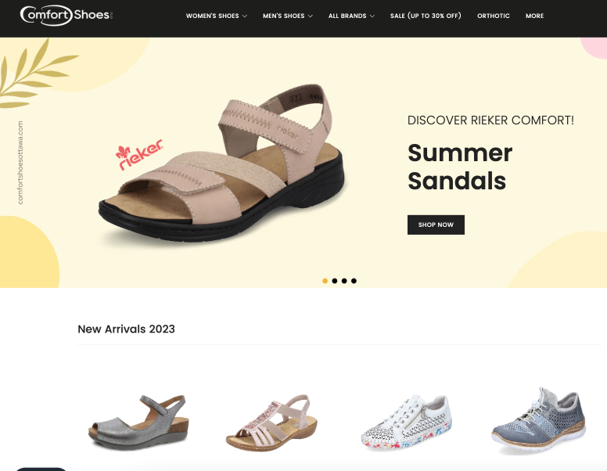
Old Website
WordPress, 2017
New Website
Shopify, 2022

Slide 3
Global SEO: what was done?
Changed from Wordpress to Shopify
Entered their entire stock into the Shopify database (~1400 SKUs were transferred).
Gave all products proper titles (!!!!!)
Implemented proper headlines structure (h1-h3 etc)
Product descriptions were taken directly from manufacturers/competitor websites. Content was not original, which didn’t seem to have any negative impact.

Slide 4
Local SEO: what was done?
Optimized Google Business Places Profile
Integrated the product feed with GBP so that all items show on Google Maps in real time.
Added in-store pictures, gave clearer instructions how to get to the store.

Slide 5
Strategic Considerations
We realized that with this many products the store has, it was critical to name them properly - Google would automatically rank some products. In hindsight - this was the right decision.
It was important to make sure that warehouse stock should at all times be up-to-date with what the website has. As a result, we had no issues with having to refund payments because that specific item was out of stock.

Slide 6
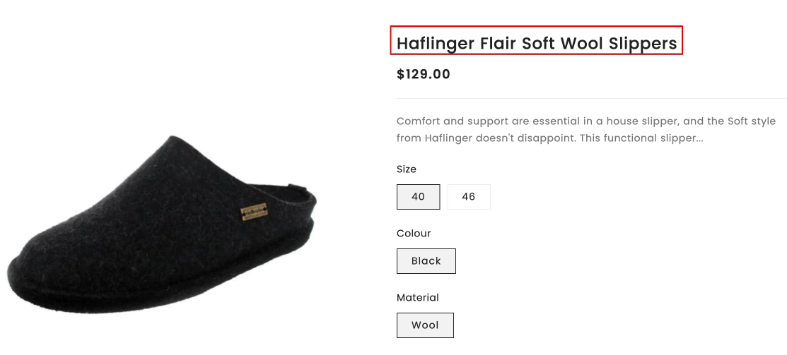
Product Titles: Naming Conventions
Brand > Material > [Gender] > Type of Shoe

Slide 7
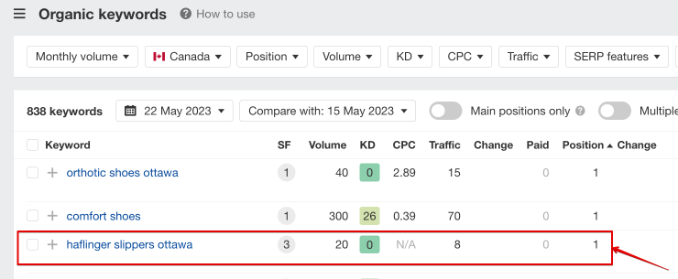
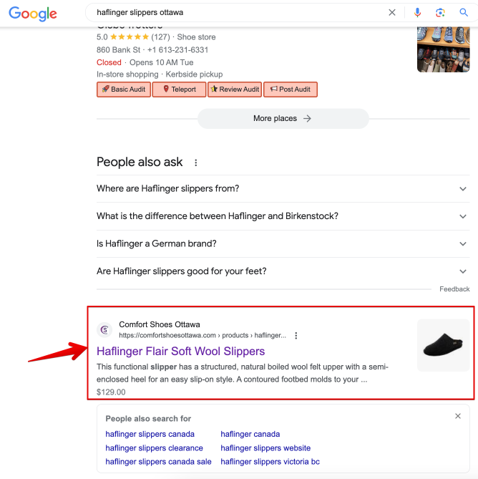
Product Titles: Results

Slide 8
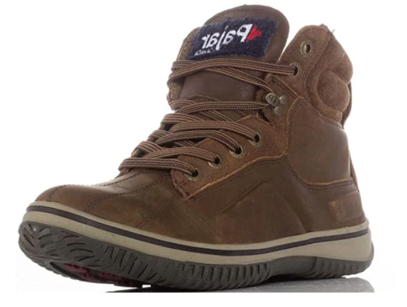
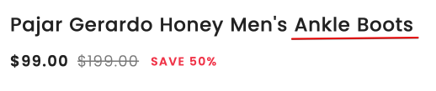

Product Titles: Naming Conventions
Brand > Material > [Gender] > Type of Shoe

Slide 9
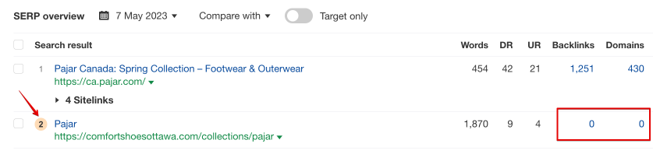

Product Titles: Results

Slide 10
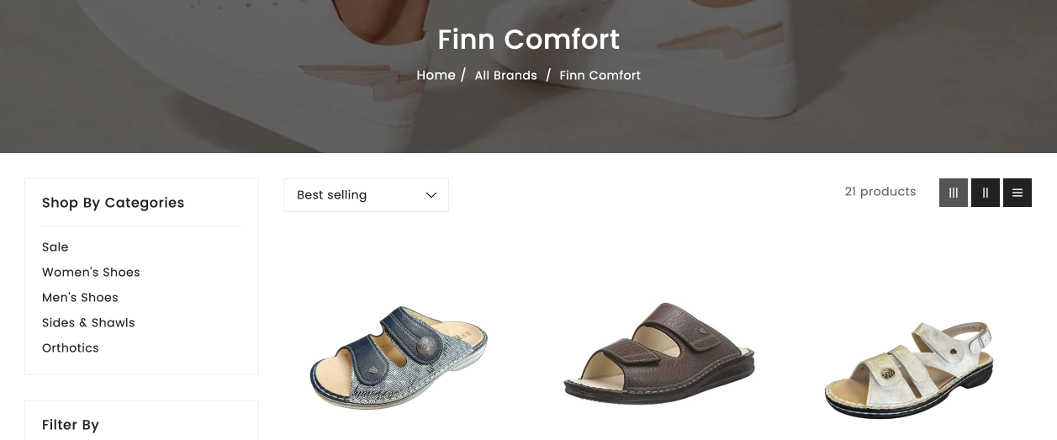
Product Titles: Naming Conventions
Brand > Material > [Gender] > Type of Shoe

Slide 11
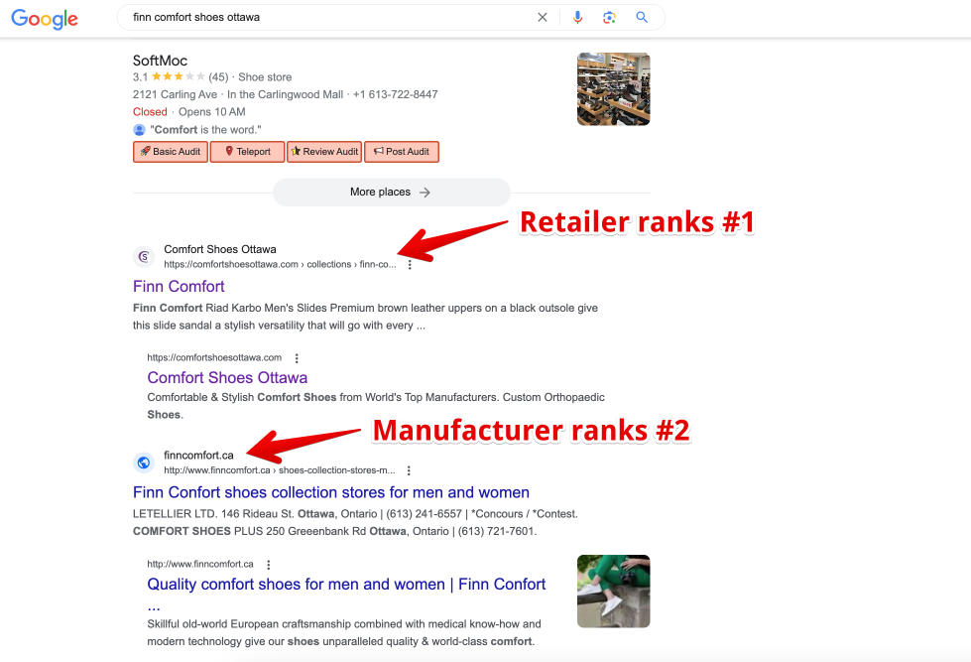
Product Titles: Results

Slide 12
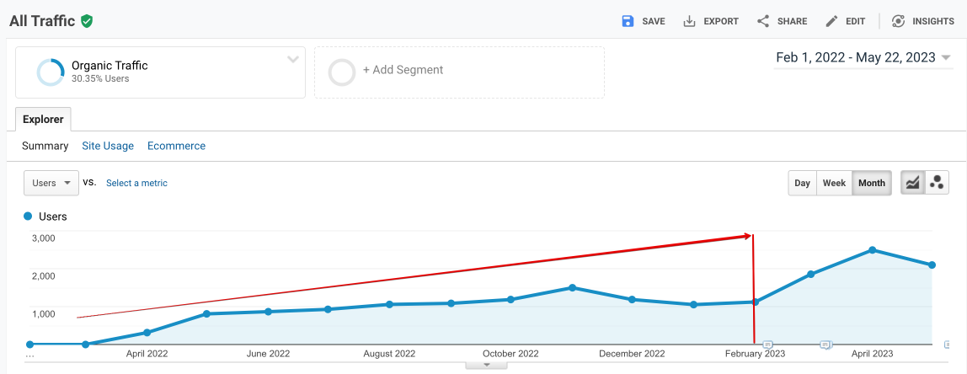
Overall Impact on Traffic
Gradual growth of organic traffic

Slide 13
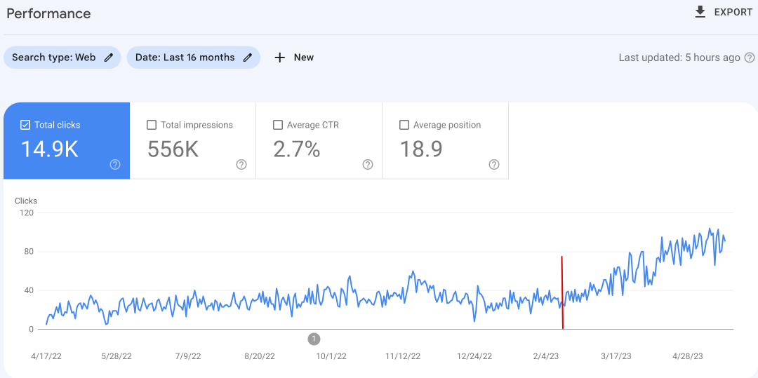
Overall Impact on Traffic
Gradual growth of organic traffic

Slide 14
Further Optimization: Iteration #2
After a short while we noticed that organic traffic wasn’t growing any more - we had hit a plateau
We started looking for further optimization opportunities
We decided to perform the following optimizations:
Technical website optimization
Adding product categories and adding them to the main navigational menu
Adding alt descriptions to all products

Slide 15
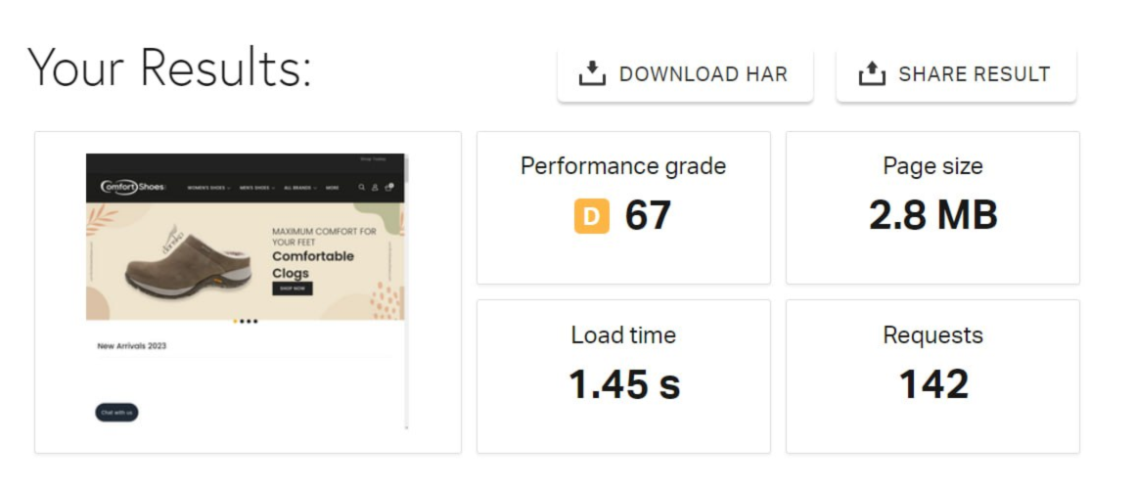
Technical Optimization
My goal: website must load in 2 seconds or less

Slide 16
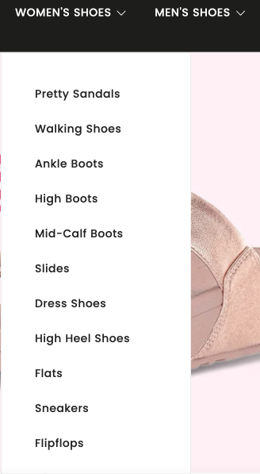
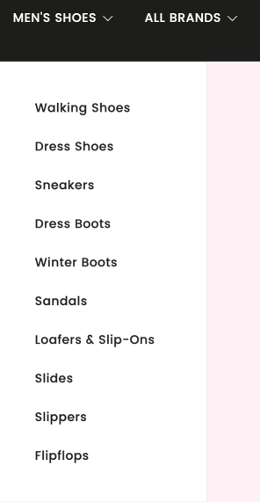
Adding Additional Product Categories
Identified most searched for shoe categories & added them

Slide 17
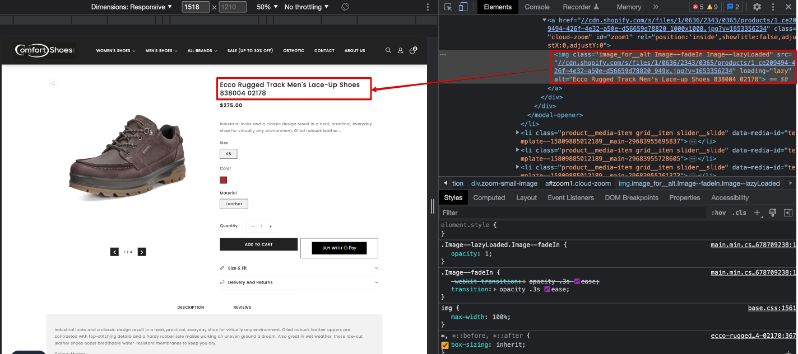
Added Alt Descriptions to Images
Used the following pattern: title > alt description

Slide 18
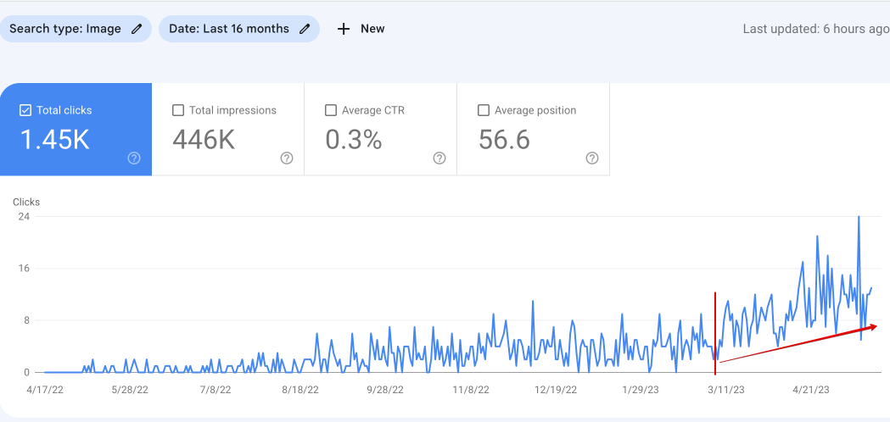
Added Alt Descriptions to Images
Results: Image Search Volume Increased

Slide 19
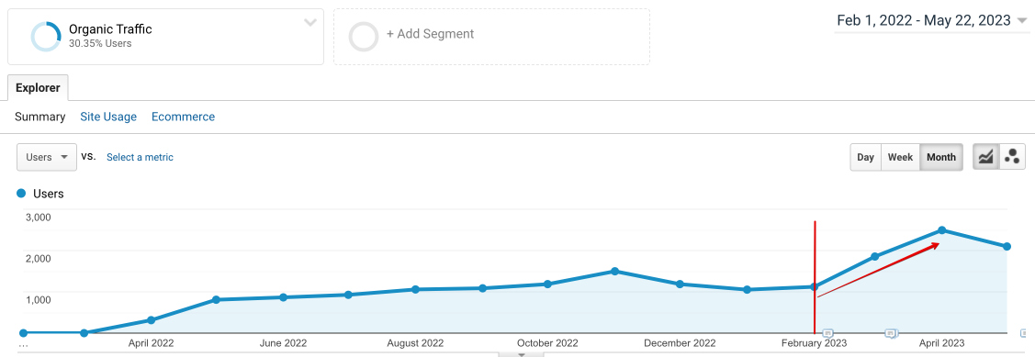
Overall Organic Traffic Increased
Results: Image Search Volume Increased

Slide 20
Overall Organic Traffic Increased
In April 2023 we hit 2,493 organic visits
On track to reach 3000 organic visits per month in May
Sales from organic have reached all time high, May is likely to beat the previous month
To date, there has been next to no link building activity

Slide 21
Observations
Not all optimizations were helpful. Some things did have a nice impact onto the overall impact, while others didn’t.
The pages that follow show what we did, what worked and what didn’t.

Slide 22
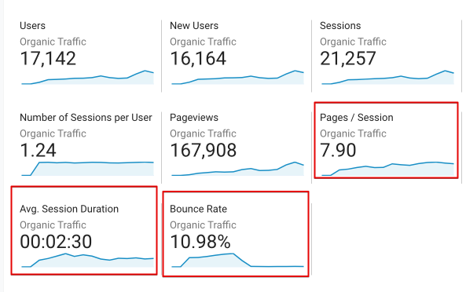
Observations: Behavioral Metrics
Good behavioral metrics don’t have a visible impact onto this project’s ranking. This website has low bounce rate, high session duration and decent pageviews per session, yet traffic only increased when navigation was improved

Slide 23

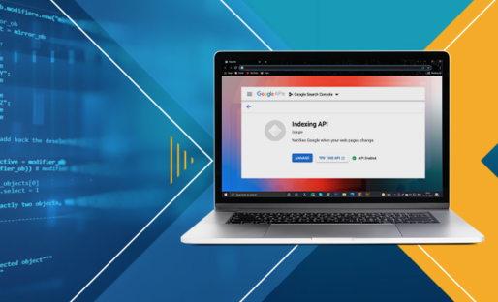
Observations: Indexing Budget
Projects with this many pages seem to run out of crawling budget quickly. Some pages in Google Search Console appear as ‘discovered, not indexed’.
Solution: We set up a Google Indexing API and submitted all the new pages to Google via a Python Script.

Slide 24
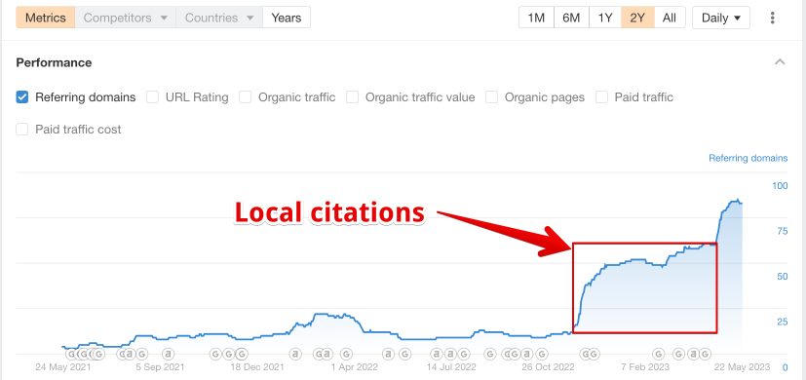
What Didn’t Work: Catalogs
Catalog registrations, which are expected to have an impact on local SEO, didn’t have a visible impact. In November we registered the business in over 70+ catalogues, only 35 were indexed.

Slide 25
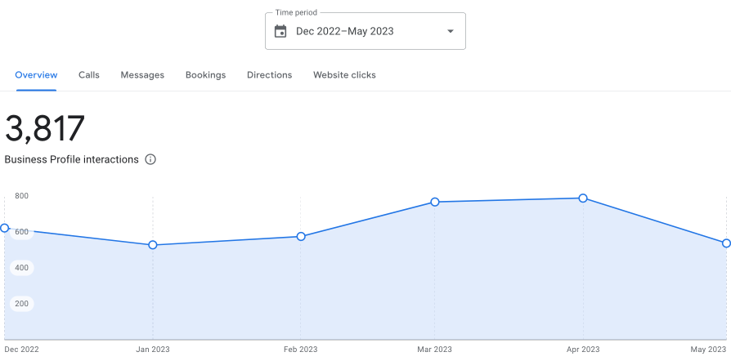
What Didn’t Work: Catalogs
Catalog registrations didn’t have a visible impact onto the GBP performance. The spike we see in Feb, Mar & April is seasonal increase of demand (so is Nov & Dec 2022)

Slide 26
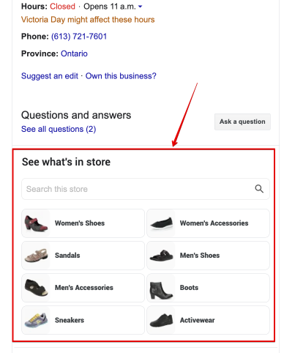
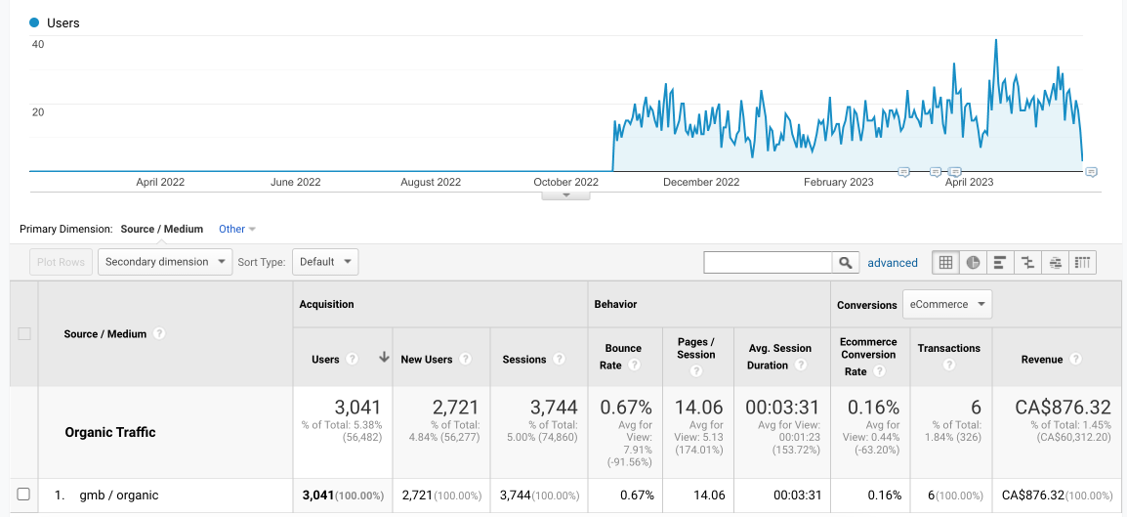
What Didn’t Work: Free Local Listings
Free Local Listings show up as additional justifications on GBP listings and in theory should drive sales. In reality, they don’t seem to - only 6 sales since October 2022

Slide 27
What Didn’t Work: Product Descriptions
We concentrated huge efforts on optimizing product descriptions from certain collections.
It didn’t have any visible impact onto rankings.
Instead, optimizing product titles, adding proper H1, H2 and H3 headlines increased keyword visibility and improved rankings
When we implemented proper headings, product collections started ranking. Before, only individual products were ranking.

Slide 28
Conclusions
Proper naming conventions for your products have a huge impact onto the website SEO, helping both organic traffic and free listings in the Merchant center.
Implementing Proper headlines structure helped Google to associate keywords with specific collections vs. individual items (e.g. pajar boots, haflinger slippers etc)
Implementing product descriptions didn’t have any visible impact onto product rankings
Adding proper collections by shoe type has given product rankings a solid boost.

Slide 29
Thank You!
I hope this information is helpful for your current and future projects

