Slide 1

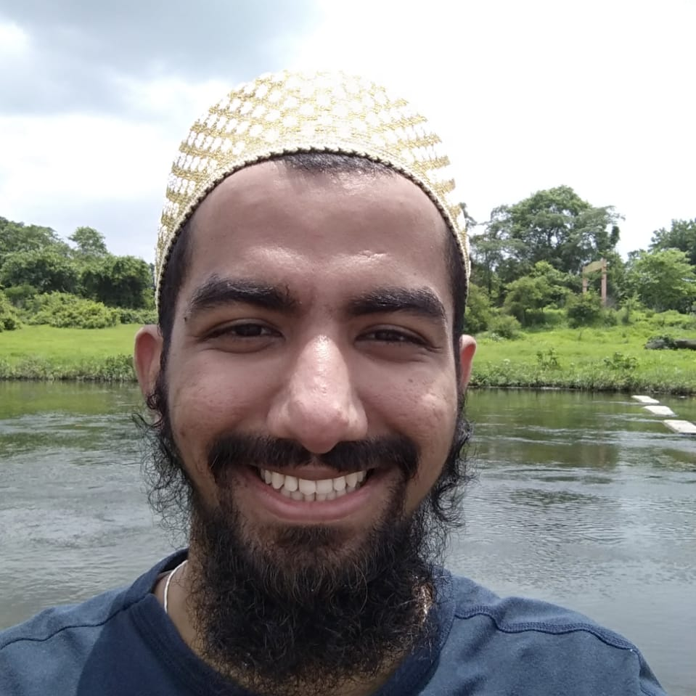


How to Get your Tech SEO Changes Implemented, FAST!
Mufaddal Sadriwala
SEO Manager at Assembly MENA Independent SEO Consultant
@greatmuffi
Mufaddal Sadriwala

Slide 2
Climbing a Mountain is the 2nd most difficult thing to do in the World!!

Slide 3
Climbing a Mountain is the 2nd most difficult thing to do in the World!!
Getting your changes implemented on the website remains the 1st!

Slide 4
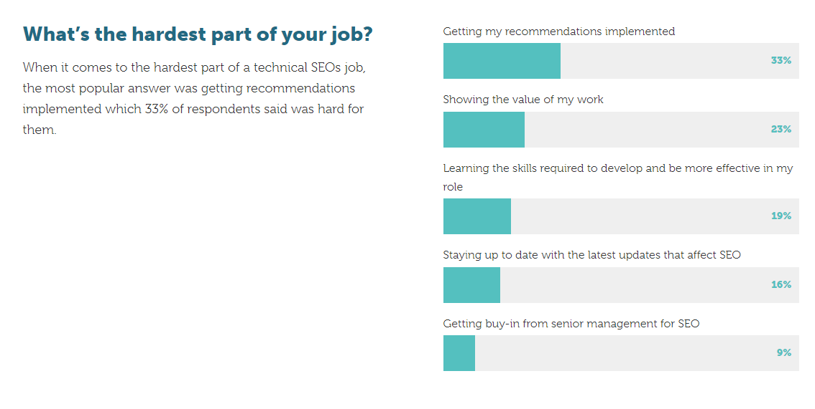
33% SEO’s Says the hardest part of their job is “getting SEO recommendations implemented”
Source: https://aira.net/state-of-technical-seo/the-impact-of-technical-seo/

Slide 5
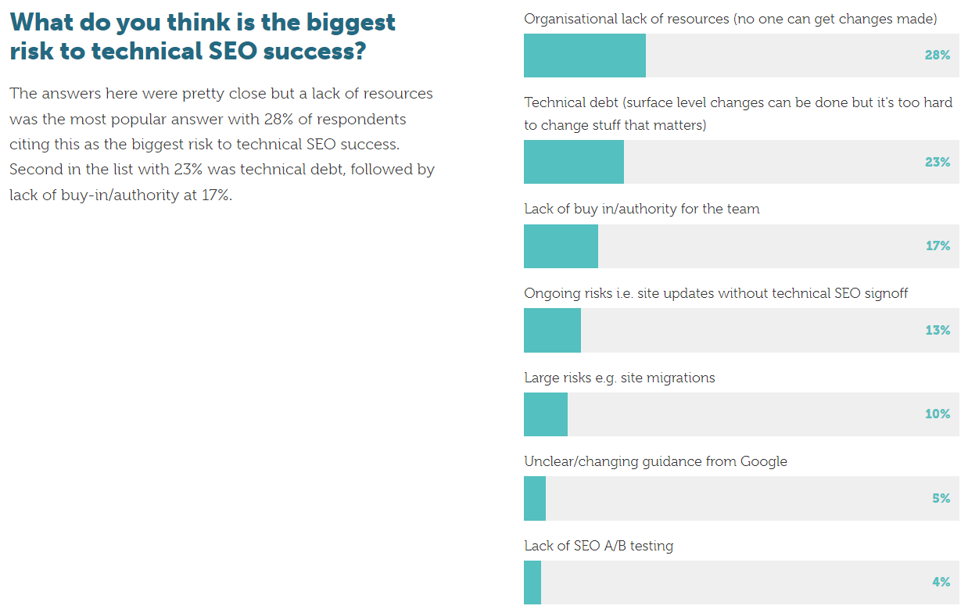
28% “says lack of resources”
is the biggest risk to technical SEO success!!
Source: https://aira.net/state-of-technical-seo/the-impact-of-technical-seo/

Slide 6
We might have a 100 page audit with a lot of valuable suggestions but it means nothing if it’s not implemented!

Slide 7
And for getting changes implemented, we need to work with a Web Developer!

Slide 8
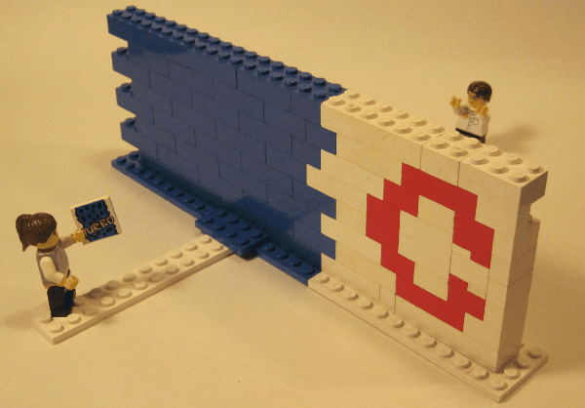
But working with developers
isn’t easy

Slide 9
That’s why, I’m here to talk about
how we we were able scale organic traffic for a brand by 430% in a year,
by efficiently working with a talented team of web developers

Slide 10
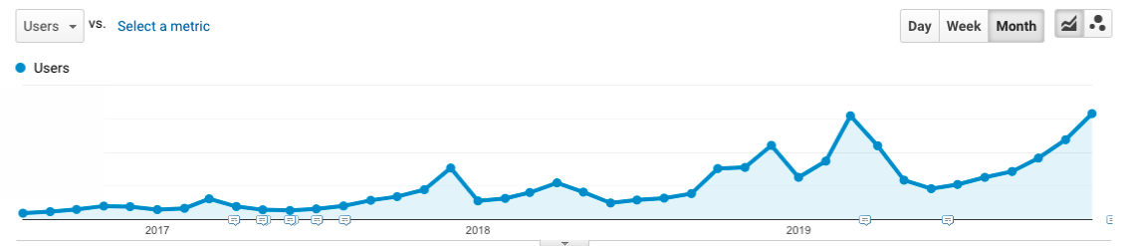
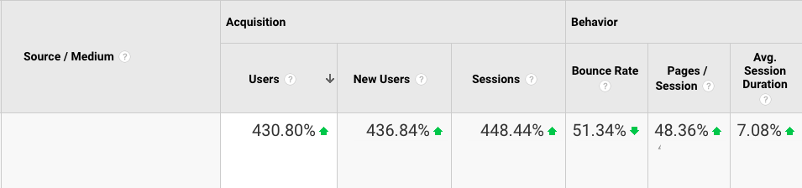
From ~50K visits to ~300K in traffic!
Notes:
Over the years, the traffic has shot up significantly (a 430% increase YOY) and has resulted in it becoming the top-ranked website for event related searches.

Slide 11
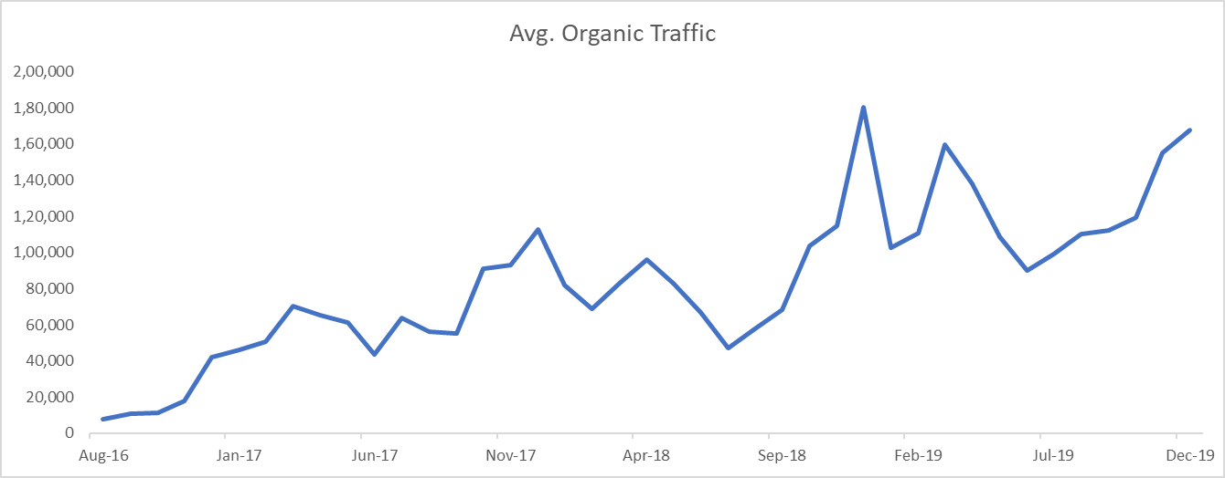
From ~50K visits to ~300K in traffic!
Notes:
Over the years, the traffic has shot up significantly (a 430% increase YOY) and has resulted in it becoming the top-ranked website for event related searches.

Slide 12

So, how do we do this?

Slide 13
Let’s just understand
why is it difficult to work with a Dev?

Slide 14
Their job is not just to implement SEO recommendations

Slide 15

2. They have their own sets of problems to solve!
Notes:
Their priorities would be different. (front-end, back-end, server, etc.)

Slide 16

3. They have a limited understanding of Marketing & SEO
Notes:
Their priorities would be different.

Slide 17

4. They think we SEO’s just dump the work on them (the hard truth)

Slide 18
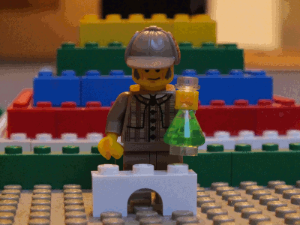
Coming back, so, what should we do?

Slide 19

The foundation step is to build real relationship with your client & developers!
Notes:
Become problem solvers for them. Try to get more involved with them with your Know them in and out. Build a personal relationship rather than professional.

Slide 20

2. Get Stakeholders Buy-in at the very early stage of the SEO Campaign
Notes:
Stakeholders buy-in will get your recommendations get implemented

Slide 21
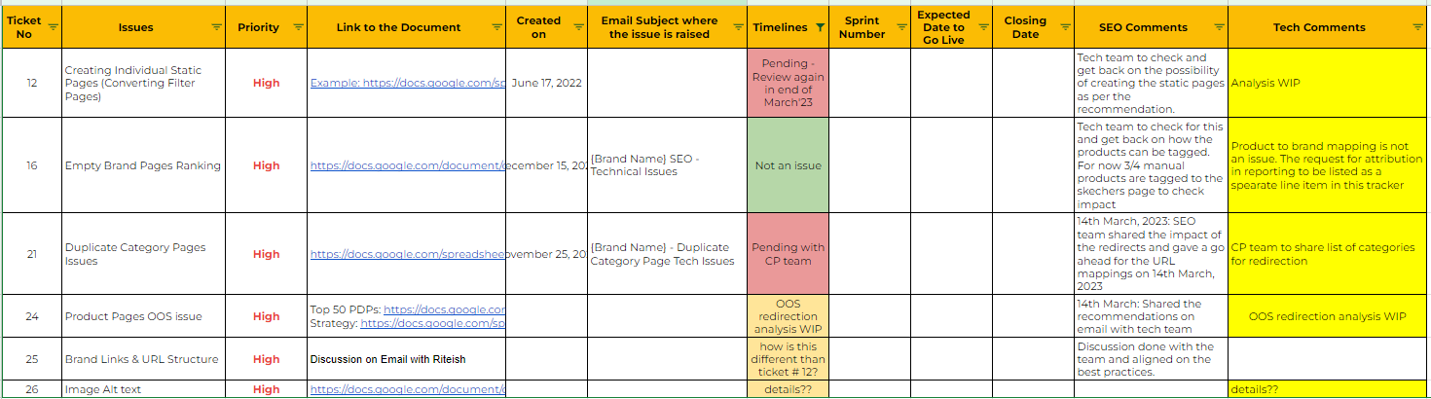
3. Maintain a single process for updates & communication
Use JIRA/sheets/doc/Trello/Slack whatever works best for you and the team.
Maintain a single tracker to keep a tab on progress
Notes:
Avoid email communication so that there not multiple threads going on in different places

Slide 22
4. Send Clear & Concise instructions
While creating request, send clear instructions/requests/suggestions
Be as specific as possible
Don’t assume things

Slide 23
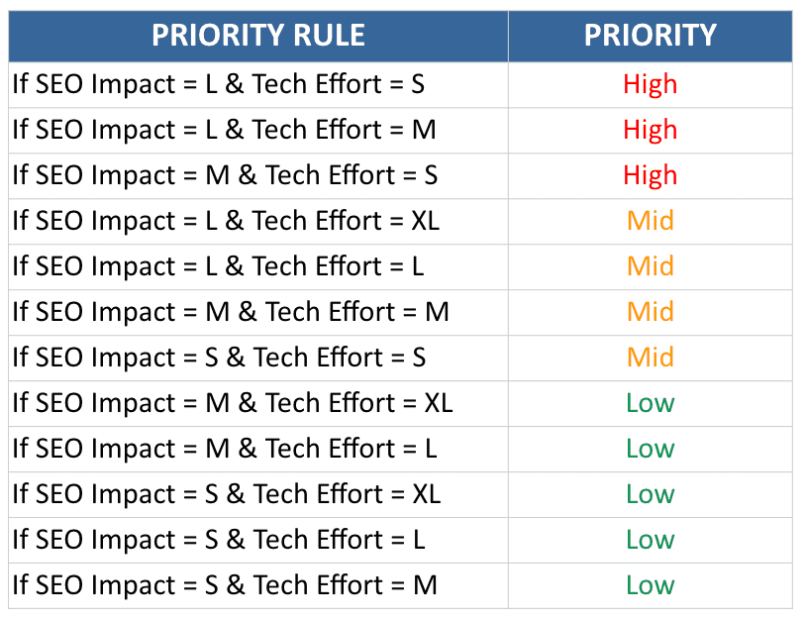
4. Prioritise the recommendations
Share the most quickest win and impactful task.
Note: Not all the audit findings has to be implemented.
Credits to Areej Abuali
Notes:
Share the most impactful tasks with them which can take the least amount of time
For example:
updating the meta tags on the website
updating URLs
bugs
Followed by other tasks
Don’t directly start with design level and complex changes from DAY 1

Slide 24
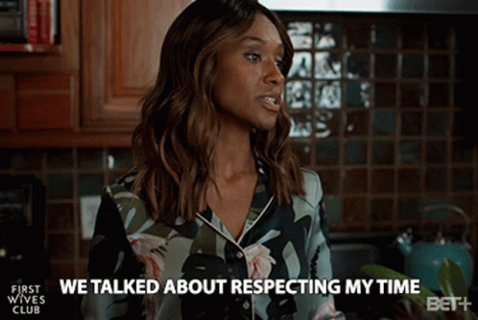
5. Respect and Understand the Dev’s Time and Resources
Notes:
They have their own sets of issues, don’t assume they are free to work on
our recommended changes all the time.

Slide 25

6. Share SEO WINS with them
Keyword Ranking Improvement
Revenue & Traffic Increase
SERP Features started displaying because of schema implementation
GSC Page Experience report improvement

Slide 26

7. Understand the complexity of the tasks before sending it
Notes:
If you want a dancing monkey on the home page, understand the cost and complexity the Monkey will bring. Ask them the possibility.

Slide 27

8. Educate them about Tech SEO
Notes:
A few examples:
The significance of fast loading websites and Google’s emphasis on Core Web Vitals
Difference between Canonicals & Redirects for Google (because for them both these would mean same thing)
Why content inside JS must be avoided

Slide 28

9. Make them believe in you by backing up your recommendations with strong data.
Notes:
Back up your suggestions from GA/GSC/or any other tools. Show them how much it is impacting the website

Slide 29

10. Show the bottom line impact of doing SEO
Increased revenue
Improvement in conversion rate through organic traffic
Assisted Conversions
Brand Discovery

Slide 30

11. Spoon feed them
Notes:
Not every time. But initially, to build trust.
In the case of developers from the client’s end, you might have to do it frequently. In my experience, I have noticed going above and beyond our

Slide 31
But we are doing all of these already, but the Dev is still not moving the tickets :-(
@greatMuffi

Slide 32
Don’t impose tasks on them
@greatMuffi

Slide 33
Example
Recommendation: How to Improve Load Time?
Use multiple tools and audit the root problem yourself. PSI, GTMetrix, GA, etc.
Find the reason behind the high-load time
Notes:
Suppose you want to improve page load of the website in a given month:
Use multiple tools and audit the root problem yourself. PSI, GTMetrix, GA, etc.
Figure out 1-2 quick wins
Example -
If the header image is 1-2 MB in size, compressing it can improve the load time by 1 second.
Compress the image yourself and share it with them to replace.
Along with it, share suggestions and a link that lists down more optimisations.

Slide 34
What should Dev’s do?
@greatMuffi

Slide 35
What should Dev’s do?
Listen to and understand what SEO’s are suggesting.

Slide 36
What should Dev’s do?
Be open to learning SEO (it might change your perspective + it’s not that bad!)

Slide 37
What should Dev’s do?
Think outside the box for solutions (outside code and design)

Slide 38
What should Dev’s do?
Please, give importance to SEO’s :-)

Slide 39

In the end - The SEO & Dev’s should:
Turn this
In to this

Slide 40
A bit about me:
From Mumbai, India.
8 Years ago, I started as a local lead generation freelancer in 2015.
Currently working as an SEO Manager at Assembly MENA.
Fun fact: I learn something new each passing day.
Best thing about SEO: it doesn’t have a blueprint!

Slide 41






Thank you!
greatmuffi@gmail.com
https://mufaddal.digital

Slide 42

Here’s the download link to my slides

